Slide 1
Final Project Presentation
The Flying Wombats

Slide 2


System Design
Purpose: The purpose of this project is to create a turn-based combat game that can be both engaging to play and play itself.
System Overview: The game has been developed in unity and using Google’s Firebase.
System Architecture: Desktop based software requiring a mouse, using the unity engine, C#, SQL, and Firebase
Database: The database stores player log-ins and game stats.
System Security: The main level of security is the log-in system and any security already integrated into unity and firebase

Slide 3
Roles and Responsibilities
Samuel Maynard: Project Manager and art direction
Shane Callaway: Assist with UI design and function, basic level combat, player and enemy stats, leveling, and balancing of combat
Thomas Mattei: User Interface/Menu Transitions, Assist with Online PvP
Alton Stillwell: Online Matchmaking (PvP) Programming, Mirror Integration, Audio
Kaitlyn Staats: Database design and integrating the database into unity.
Evan Colyer: AI programming, both for player characters and enemy non-player characters.

Slide 4
Audio
Music and looped sound (wind) are attached to Unity game objects in their respective game scenes
Sound effects like melee hits are routed through the audio manager script, minimizing the amount of code that needs to be added to PlayerCharacter, EnemyCharacter, and the CombatControl scripts

Slide 5
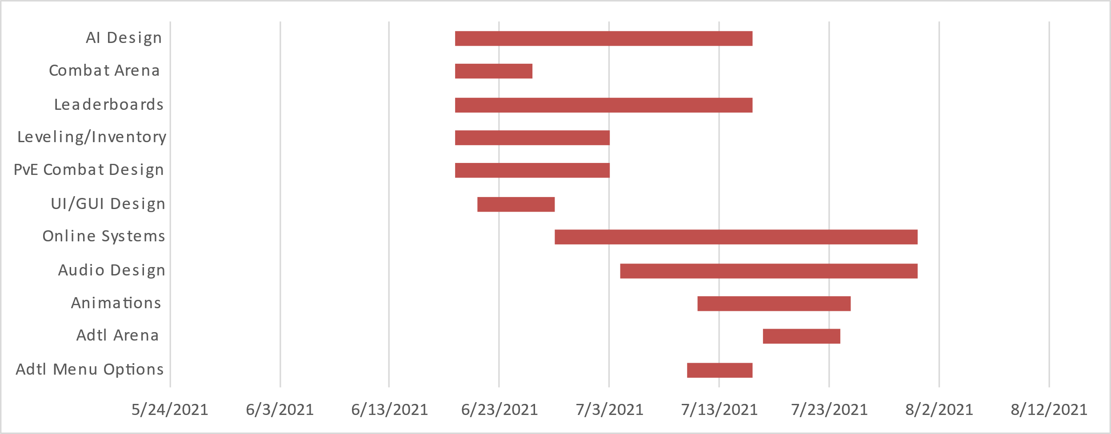
Gant Chart
Task Name | Start | End | Duration (days)
Adtl Menu Options | 7/10/2021 | 7/16/2021 | 6
Adtl Arena | 7/17/2021 | 7/24/2021 | 7
Animations | 7/11/2021 | 7/25/2021 | 14
Audio Design | 7/4/2021 | 7/31/2021 | 27
Online Systems | 6/28/2021 | 7/31/2021 | 33
UI/GUI Design | 6/21/2021 | 6/28/2021 | 7
PvE Combat Design | 6/19/2021 | 7/3/2021 | 14
Leveling/Inventory | 6/19/2021 | 7/3/2021 | 14
Leaderboards | 6/19/2021 | 7/16/2021 | 27
Combat Arena | 6/19/2021 | 6/26/2021 | 7
AI Design | 6/19/2021 | 7/16/2021 | 27

Slide 6
Change Log
Change Log
Project: Turn-Based Combat Game |  |  |  |  |  | Date: 7/31/21
Change No. | Change Type | Description of Change | Requestor | Date Submitted | Date Approved | Status | Comments
1 | Design/Scope | The removal of an additional combat arena | Sam M. | 7/3/21 | 7/3/21 | Approved | No additional combat arenas were added to the game due to time constraints
2 | Design/Scope | Change from using MySQL for the database to Google Firebase | Kaitlyn S. | 7/5/21 | 7/16/21 | Approved | Change made due to cost and time constraints, as well as ease of use for the developers and end user
3 | Design/Scope | Open world environment and related gameplay elements scrapped | Sam M. | 6/7/21 | 6/7/21 | Approved | Open world concept scrapped due to concerns of exceeding the scope of the game design
4 | Design/Scope | Scrapping character customization/multiple characters per player | Kaitlyn S. and Alton S. | 7/10/21 | 7/10/21 | Approved | Scrapped due to technical difficulties for KS and AS developing backend systems
5 | Design/Scope | Removing the requirement for a Google account for player signup | Kaitlyn S | 7/3/21 | 7/10/21 | Approved | The requirement of a Google account to create an account in game scrapped due to technical limitations
6 | Design/Scope | Scrapped the addition of an “endless” game mode | Shane C. | 6/21/21 | 6/21/21 | Approved | Scrapped additional mode due to worries of exceeding development scope
7 | Design/Scope | Scrapped the addition of an online “PvP” mode | Alton S. | 7/31/21 | 7/31/21 | Approved | Unable to get online “PvP” system functional within deadline

Slide 7
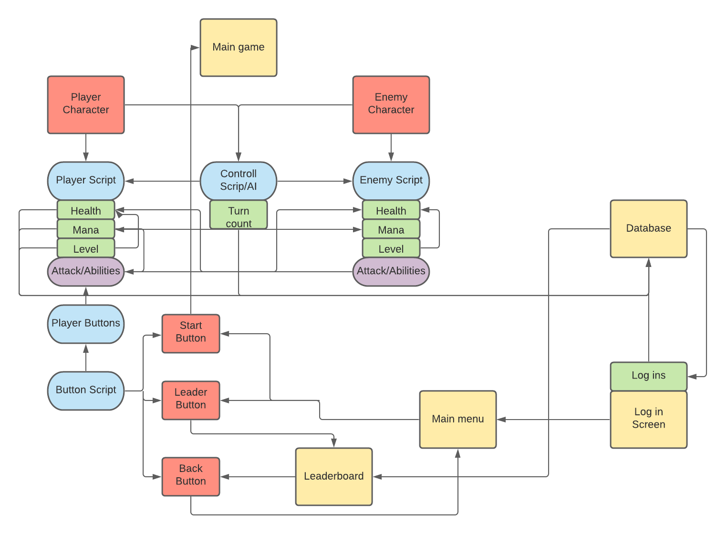
Relationship Charts

Slide 8
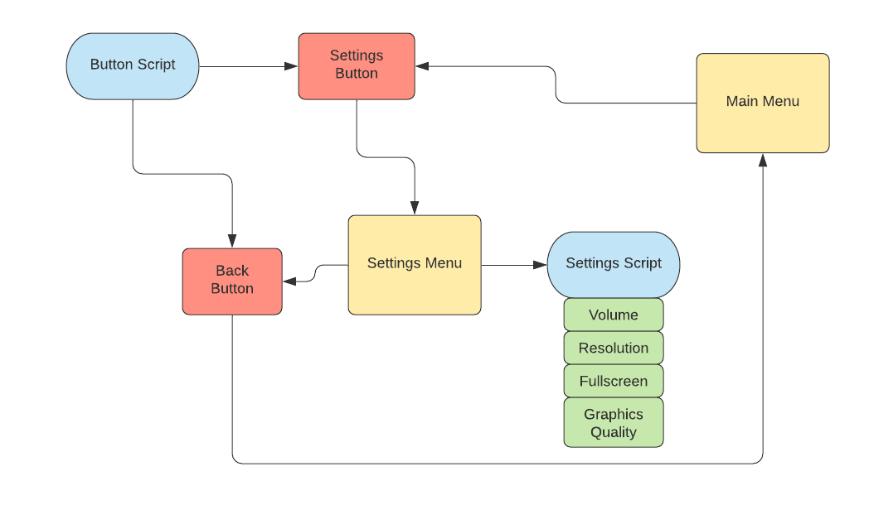
Relationship Charts Cont..

Slide 9
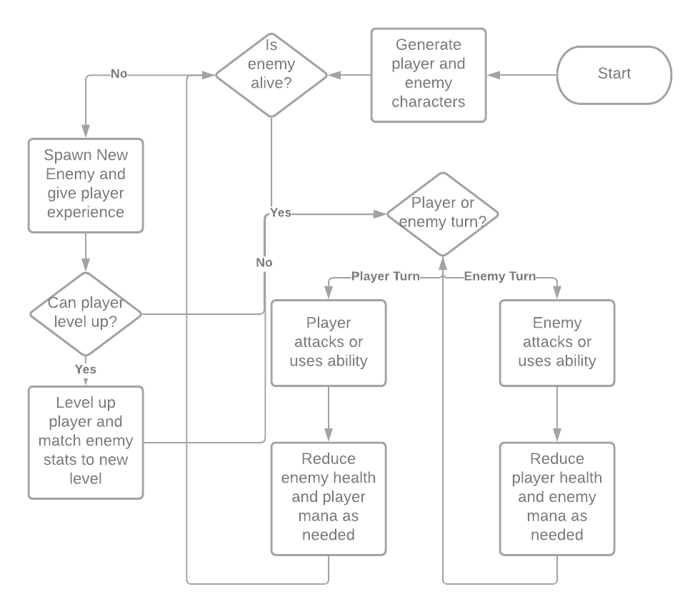
Combat Dataflow Chart

Slide 10
Lessons Learned
Category | Issue Name | Problem/Success | Impact | Recommendation
Scope | Good, big ideas | During initial development stages, good, but exceeding scope, ideas were presented, causing confusion on what would be developed and what wouldn’t. | Many good ideas for the game were shared, but then held onto for too long and not properly communicated on their status, causing confusion among the developers on what was in or out of development scope | Project manager should better communicate large design changes and make clear to the rest of the team which ideas are being taken forwards, and which ideas need to be cut in order to develop the project in a timely manner
Scope | Complicated Systems, Lack of Experience with Online Systems | The planned system of online Player versus Player was not completed in time for the project deadline. | One of the two planned battle modes did not make completion, giving players a much more limited experience | PvP developer(s) should better communicate updates and problems with developing their online matchmaking system
Audio | Audio System Implementation | Both music and sound effects were successfully added to the final version of the project utilizing multiple methods | In-game audio provides a more user-orientated experience | Future Unity projects could utilize these methods for ease-of-implementation and user experience
Teamwork | Sharing Files via GitHub and other services | Occasional issues uploading and copying repository from GitHub | Made early progress a bit more difficult, as unity files are not directly shareable in the same format at times | The only real solution is patience and cooperation from all members involved.

